Slide 1
Multithreading
Rajasekaran S
Assistant Professor,
Department of Information Technology,
KGiSL Institute of Technology,
email: proffraja@gmail.com
Github:www.github.com/rajasekaranap

Slide 2
Types of System
Single Processing.
Only one CPU is available.
It can run one program at a time.
Other programs must wait until CPU is released.
Multiprocessing
More than one CPU available.
It can run programs parallel.
It saves time in mutilcore processors.

Slide 3
Types of System
Single programming.
It can load and execute single program in a memory.
Other program even waits to load into memory.
Multiprogramming.
It can load more than one program into different parts of memory.
If one process waits for I/O then context switch is performed and other process is executed.

Slide 4
Types of Systems
Multitasking
Each program can have n number of task’s.
Similar to multi programming but a part of a program [task] get executed instead of whole program.
Single CPU performs multiple task based of context switching .
Task is sub unit for whole program can be compared to single thread.

Slide 5
Types of Systems
Multithreading.
It takes the advantage of multi processor systems.
A single process is executed in multiple cores in a single context.
Part’s of a program can execute concurrently in multiple cores.
Multiple Programs -> Multitasking - > Multicores

Slide 6
Threads
A thread is a lightweight sub-process, the smallest unit of processing.
Multiprocessing and multithreading, both are used to achieve multitasking.
It shares the same memory area.
Context switching between thread is faster.

Slide 7
Advantages
It doesn't block the user because threads are independent and you can perform multiple operations at the same time.
We can perform many operations together, so it saves time.
Threads are independent, so it doesn't affect other threads if an exception occurs in a single thread.

Slide 8
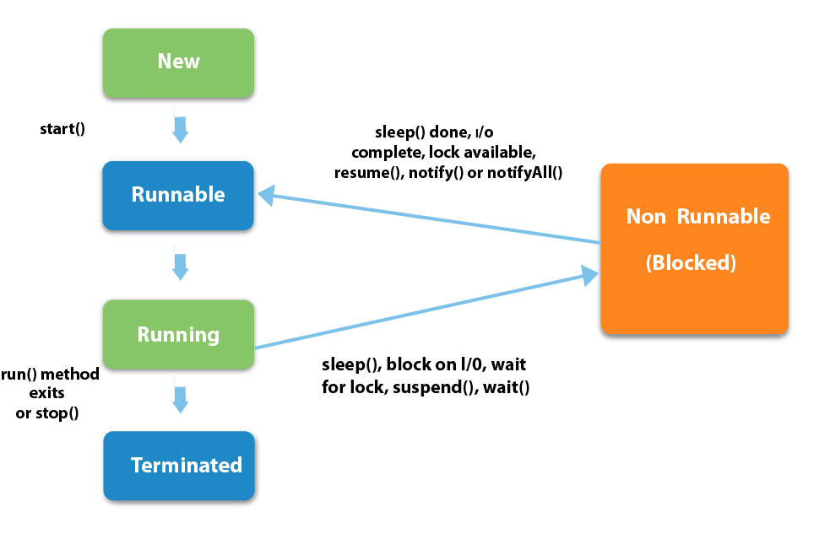
Life Cycle of Threads
Wait

Slide 9
Sates of Thread
New
The thread is in new state if you create an instance of Thread class but before the invocation of start() method.
Runnable
The thread is in runnable state after invocation of start() method, but the thread scheduler has not selected it to be the running thread.

Slide 10
Sates of Thread
Running
The thread is in running state if the thread scheduler has selected it.
Non-Runnable/Blocked/Waiting
This is the state when the thread is still alive, but is currently not eligible to run.
Terminated
A thread is in terminated or dead state when its run() method exits.
It is no longer available to execute.

Slide 11
Creating Threads in Java
A class must extend form Thread.
Override run() method of Thread class.
Create an instance for user thread class .
Call the start method to invoke the thread.
LifeCycle Methods
void start()
void run()
void wait()
void stop()

Slide 12
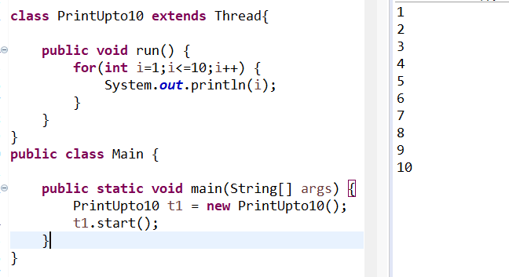
Simple Thread That Prints upto 10

Slide 13
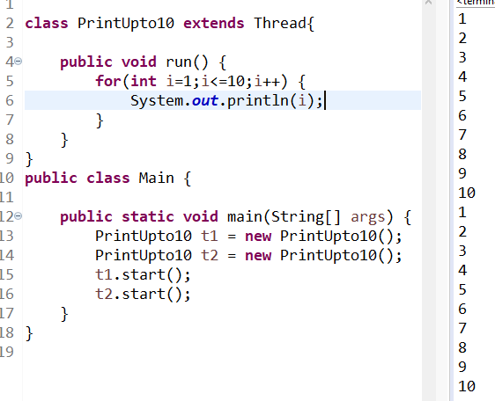
Invoking two threads

Slide 14
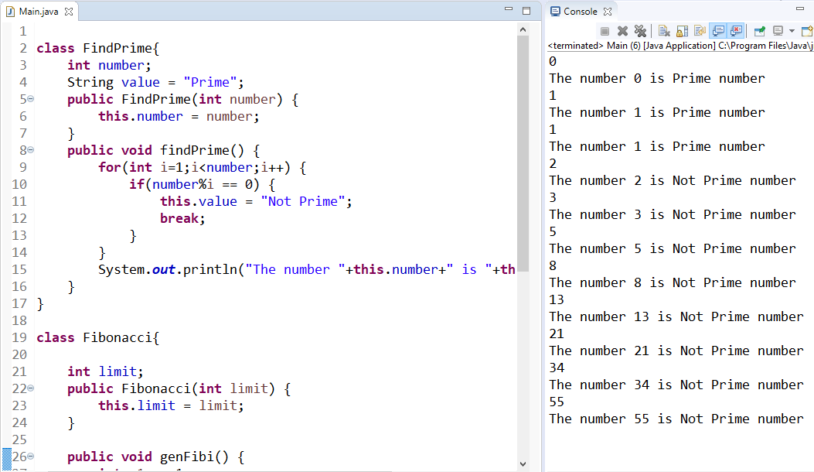
Fibonacci and Prime [Non Threading Approach]

Slide 15
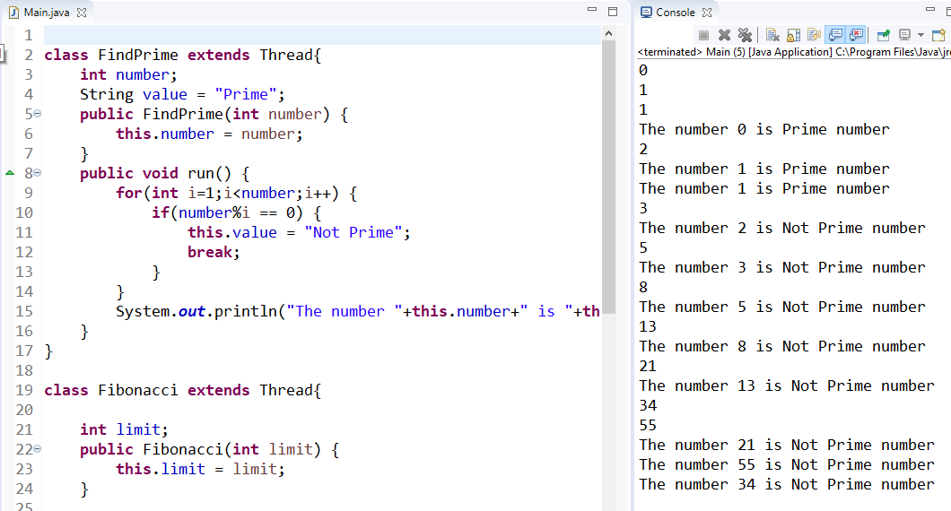
Fibonacci and Prime [Threading Approach]

Slide 16
Thank You
Rajasekaran S
Assistant Professor,
Department of Information Technology,
KGiSL Institute of Technology,
email: proffraja@gmail.com
Github:www.github.com/rajasekaranap

